Slide 1

python

Slide 2

Introduction(“hello”)

Slide 3

History of Python() Inception and Development
1
2
3
4
5
6
7
8
9
10
11
12
13
14
15
16
17
18
19
20
21
22
23
24
Python was introduced by
Guido Van Rossum in 1989.
filename =“Rossum.png”

Slide 4

Origin=
25
26
27
28
29
30
31
32
33
34
35
36
37
38
39
40
41
42
43
44
45
46
47
48
In the early 1980s, Van Rossum used to work as an implementer of the programming language called ABC at CWI
(“Centrum Wiskunde & Informatica”).
CWI is the national research institute for mathematics and computer science in the Netherlands. Founded in 1946.
filename =“cwi_logo.png”

Slide 5

Why? What lead to python development=
25
26
27
28
29
30
31
32
33
34
35
36
37
38
39
40
41
42
43
44
45
46
47
48
Later at CWI in the late 1980s, while working on a new distributed operating system called AMOEBA,
Van Rossum started looking for a scripting language with a syntax like ABC but with the access to the Amoeba system calls.
Van Rossum himself started designing a new simple scripting language that could overcome the flaws of ABC.
amoeba OS
filename =“amoeba.png”

Slide 6

First release of Python=
25
26
27
28
29
30
31
32
33
34
35
36
37
38
39
40
41
42
43
44
45
46
47
48
Van Rossum finally introduced the first version of that programming language in 1991.
(i.e. Python 1.0)
This initial release has module system of Modula-3. Later on, this programming language was named ‘Python’. By 2017 the evolution of Python has reached up to Version 3.x.
filename =“modula_3.png”

Slide 7

Where is Python used?= gaming[]
25
26
27
28
29
30
31
32
33
34
35
36
37
38
39
40
41
42
43
44
45
46
47
48
Python modules like PyGame and
Pandas 3D are able to make basic
games.
Many games developers use Python
scripting, like Electronic Arts
with their games Battlefield
and the Sims.
filename =“battlefield.png”

Slide 8
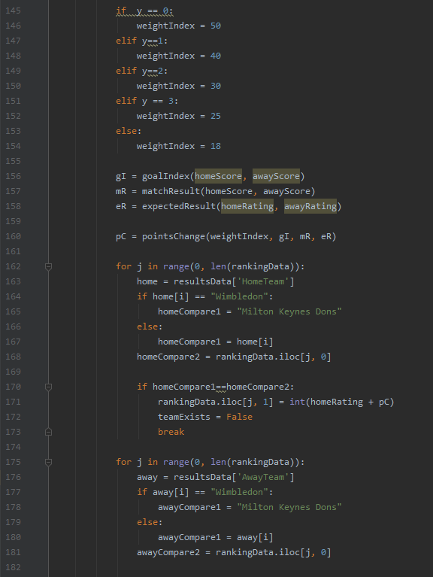
Where is Python used?= 3D Modelling[]
25
26
27
28
29
30
31
32
33
34
35
36
37
38
39
40
41
42
43
44
45
46
47
48
Popular modules like NumPy and SciPy are
common place in mathematical models
and simulation.
The Pandas module allows easy access to
databases and CSV/Excel files.
NASA and SpaceX both use Python for
simulating flights.
simulation = pandas.read_csv(“data.csv”)

Slide 9

Where is Python used?= 3D Modelling[]
25
26
27
28
29
30
31
32
33
34
35
36
37
38
39
40
41
42
43
44
45
46
47
48
3D modelling engine Blender uses Python back-end scripting, and allows the user to edit the code to their needs.
Photo editing software like GIMP (GNU Image Manipulation Program) also uses the language.
filename =“GIMPLogo.png”

Slide 10

Where is Python used?= webApps[]
25
26
27
28
29
30
31
32
33
34
35
36
37
38
39
40
41
42
43
44
45
46
47
48
Many popular web apps use Python
for its popularity and simple layout.
Every Google product is scripted in
Python, this includes
Instagram, and YouTube
Reddit also uses the language.
if owner == “Google”:
language = “Python”

Slide 11

Where is Python used?= Sports[]
25
26
27
28
29
30
31
32
33
34
35
36
37
38
39
40
41
42
43
44
45
46
47
48
Python is a powerful tool in sport analytics
In football, the language is used to code
scouting systems, predictive models and
goal line technology.
It is also used with aero-dynamic
readings in both Renault and McLaren
F1 teams.
def formulaOne(speed):
veryFast

Slide 12
Pros and Cons= pros[]
25
26
27
28
29
30
31
32
33
34
35
36
37
38
39
40
41
42
43
44
45
46
47
48
Open source
Large community of programmers contributing to the language and support forums
download for free and writing code in a matter of minutes
Fast development
Rapidly developing coding language
Makes the work easier and more efficient for developers
Do more with less code
Build prototypes and test ideas out quicker than other languages
Easy to use and read
similar to the English language that we use everyday
Python focuses on code readability. The language is versatile, neat, easy to use and learn, readable, and well-structured.
simple syntax

Slide 13
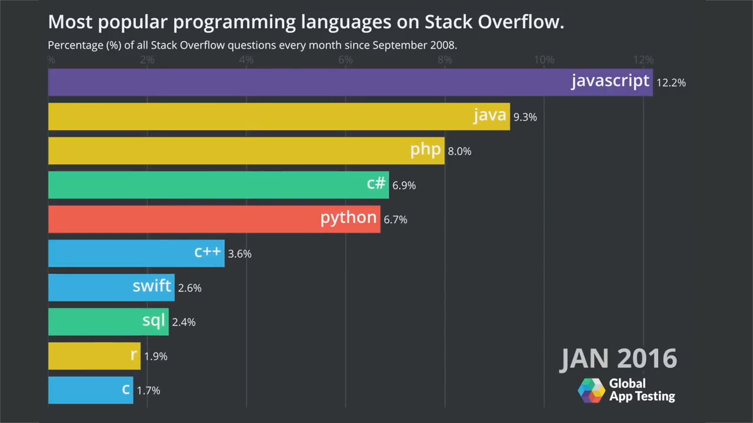
Pros and Cons= popularity()
25
26
27
28
29
30
31
32
33
34
35
36
37
38
39
40
41
42
43
44
45
46
47
48
filename =“graph.mov”

Slide 14
Pros and Cons= cons[]
25
26
27
28
29
30
31
32
33
34
35
36
37
38
39
40
41
42
43
44
45
46
47
48
Speed
Python code execution takes place with the help of an interpreter instead of the compiler. The interpreter executes the code line by line, which causes it to slow down.
Python is not the only one with speed problems. Ruby, Perl, and even JavaScript are on the slower end as well.
Simplicity
Very simple syntax which makes a programmer more of python person
harder language like Java unnecessary.
problem in learning or working on other programming languages.
Mobile
Python is significantly weaker for mobile computing.
Developers wishing to go in this direction might not find Python the best language for them.

Slide 15
if presentation == “over”: print(“Any questions?”) elif questionsLeft == 0: print(“Python is great”, thankYou)

